Slide 1
Distributed Information Systems Fall Semester – 2022 CS-423 Time and Place Lecture: Thursday 10:15 – 12:00, CM3 https://epfl.zoom.us/j/96988744528 Exercise: Monday 12:15-13:00, CM3
Karl Aberer
Distributed Information Systems Laboratory

Slide 2
Welcome back to a normal semester!
We will be working in hybrid mode
Program of today:
Hour 1: Everything you need to know on the organization
Hour 2-3: An overview of the basic concepts related to distributed information systems

Slide 3
Goals of the Course
Understand what is a "Distributed Information System"?
e.g. Web Search Engines, Online Social Networks, etc.
Know which are key tasks relevant for DIS?
e.g. retrieval, mining, recommending, information extraction, data integration etc.
Master common techniques used to solve these problems
e.g. vector space model, graph mining, word embeddings etc.
Pre-existing knowledge not required
Knowledge in databases and machine learning helpful

Slide 4
Focus of the Course
Master important Models and Algorithms for representing and processing information:
Data Science
Conceptual foundations to practically use tools and platforms for Data Science
Complementary to Applied Data Analysis by Bob West

Slide 5
Other Related Courses
In synergy with
Applied Data Analysis
Complementary to
Introduction to database systems
Database systems
Some overlaps possible with
Introduction to machine learning
Machine learning
Introduction to natural language processing
Internet analytics
…

Slide 6
Which master's program are you from?
Computer Science
Communications
Data Science
Cybersecurity
Digital Humanities
Life Science
Electrical Engineering
Environmental Science
Others

Slide 7
Did you take Applied Data Analysis?
Yes
No

Slide 8
The Course - Lecture
Standard online ex cathedra lecture
Lecture streamed via Zoom
https://epfl.zoom.us/j/96988744528
Zoom QA tool to ask questions
Will be answered privately by assistants, or by the lecturer, depending on the questions
Zoom Quizzes (anonymous)
Zoom Chat to collect feedbacks
Video recordings https://tube.switch.ch/channels/PH1KLlGUsX

Slide 9
Materials
Web platform: Moodle
General announcements will be published on Moodle
Course notes and exercises will be published on the Web in advance: https://lsir.github.io/DIS/

Slide 10
Exercises
Weekly exercises
2-3 problems to solve
Most problems will be (simple) programming exercises
Uses Python
Focus on understanding the techniques (not programming skills etc)
Exercises and exam questions from previous years will be made available as well

Slide 11
Exercise Platform
We will be using Zoom for communicating with assistants during exercises
Ed Forum to ask questions offline: https://edstem.org/eu/courses/90/discussion/
Both among students and with assistants

Slide 12
Continuous control
During the semester
Midterm programming exercise
2 Quizzes
Will be graded

Slide 13
Grading
Final Exam: 75%
Questions similar to the question in exercises and quizzes
will assume you attended the lecture
will assume you did the exercises
examples from earlier years (exercises, exams) provided for preparation

Slide 14
Exam Support
Your computer will be admitted to the exam
You will have Internet access
But: communication not allowed (messaging, social platform etc.)
You can use your notes (paper of electronically, all lecture materials)

Slide 15
Are you planning to join the lecture live or virtually?
I join live today, and plan to continue live
I join live today, but plan to join virtually
I join virtually today, and plan to continue virtually
I join virtually today, but plan to join live

Slide 16
Schedule
Week | Date | Cont. Eval. | Area | Topic
1 | 22 September 2022 |  |  | Distributed Information Systems - An Overview
2 | 29 September 2022 |  | Introduction | Information Retrieval Basics
3 | 06 October 2022 |  | Information Retrieval | Probabilistic Retrieval and Relevance Feedback
4 | 13 October 2022 |  |  | Indexing and Distributed Retrieval
5 | 20 October 2022 | Prog. midterm |  | Embedding Models
6 | 27 October 2022 |  |  | Link-based ranking
7 | 03 November 2022 |  |  | Graph Mining
8 | 10 November 2022 |  | Data Mining | Document Classification
9 | 17 November 2022 | Quiz |  | Recommender Systems
10 | 24 November 2022 |  |  | Association Rules
11 | 01 December 2022 |  |  | Semantic Web
12 | 08 December 2022 |  | From Documents to Knowledge | Information Extraction
13 | 15 December 2022 | Quiz |  | Knowledge Inference
14 | 22 December 2022 |  |  | Reserve

Slide 17
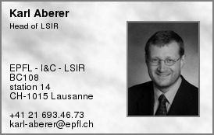
Lecturer

Slide 18
Organizational Info
Moodle
http://moodle.epfl.ch/course/view.php?id=4051
Lecturers
Prof. Karl Aberer karl.aberer@epfl.ch BC 108
Assistants
Romanou Angelika angelika.romanou@epfl.ch
Negar Foroutan negar.foroutan@epfl.ch
Mohammadreza Banaei mohammadreza.banaei@epfl.ch
Mokhtarian Ehsan ehsan.mokhtarian@epfl.ch

Slide 19
References
Parts of the course are based on the following text books
Ricardo Baeza-Yates, Berthier Ribeiro-Neto, Modern Information Retrieval (Acm Press Series), Addison Wesley, 1999.
Jiawei Han, Data Mining: concepts and techniques, Morgan Kaufman, 2000.
Christopher D. Manning, Prabhakar Raghavan and Hinrich Schütze, Introduction to Information Retrieval, Cambridge University Press. 2008.
J Leskovec, A Rajaraman, JD Ullman, Mining of Massive Datasets, 2014.
Further references to the literature will be given during the lecture

Slide 20
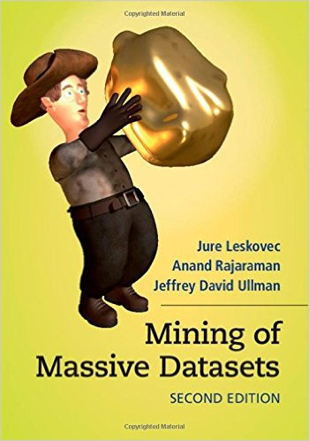
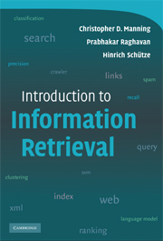
Free books
mmds.org
http://nlp.stanford.edu/IR-book/

Slide 21
Exam Date

